Slide 1
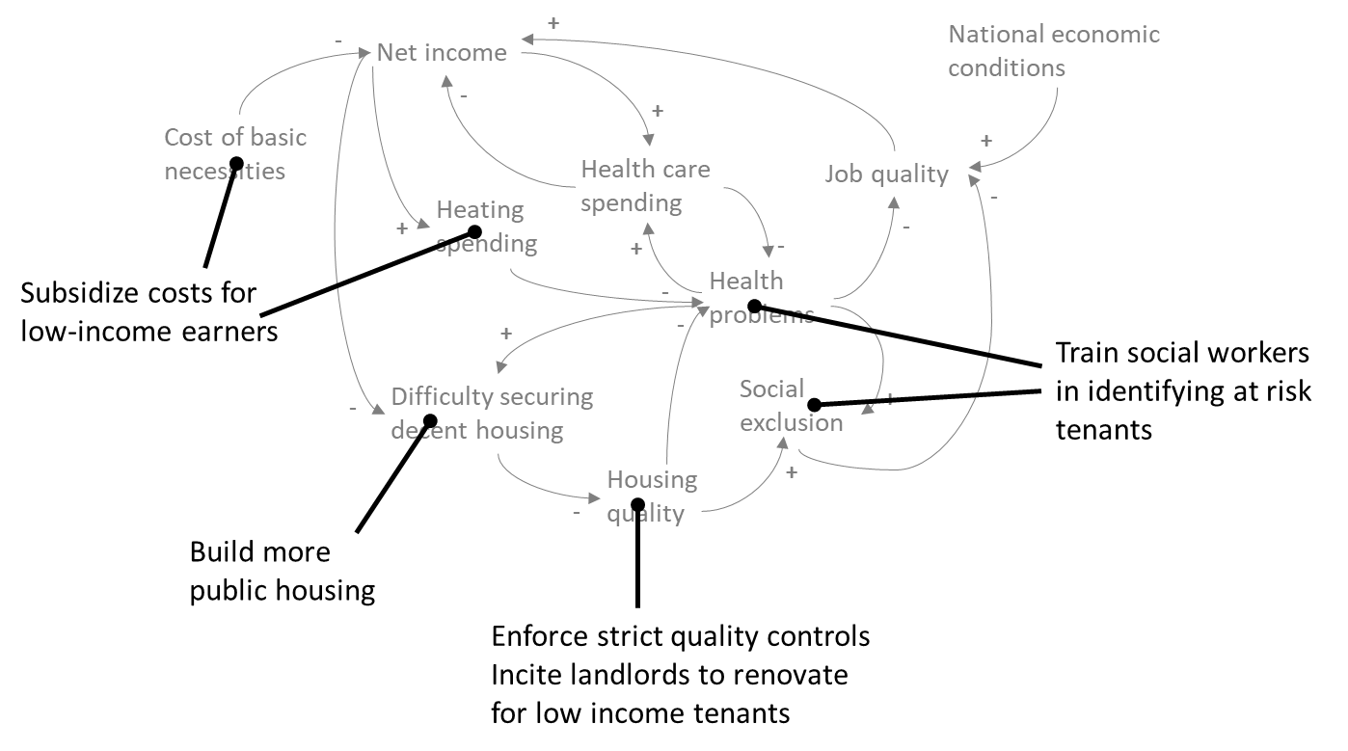
#5 Looking for leverage
Identify the system’s leverage points and suggest ways to change the undesirable behavior.
Using the model, show the leverage points that underlie your recommended actions
Tell and share your story:
Link to insightmaker.com online story

