Slide 1
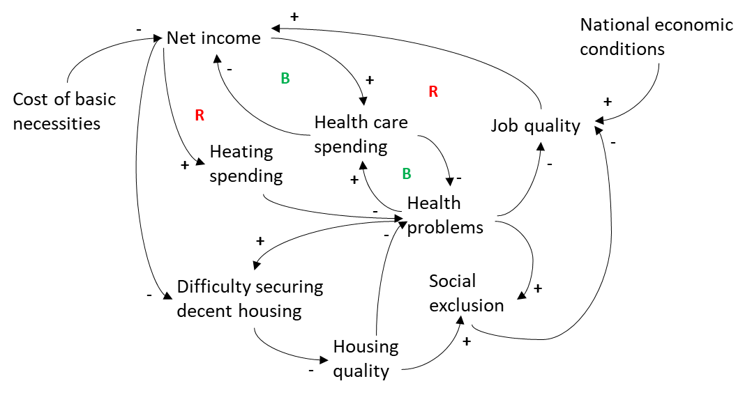
#4 Draw the system at work
Draw the causal loop diagram of the situation that explains the behavior under study.
Draw your model here
Main sources and experts consulted
List all sources and experts consulted. Use an additional slide if necessary.

