Slide 1
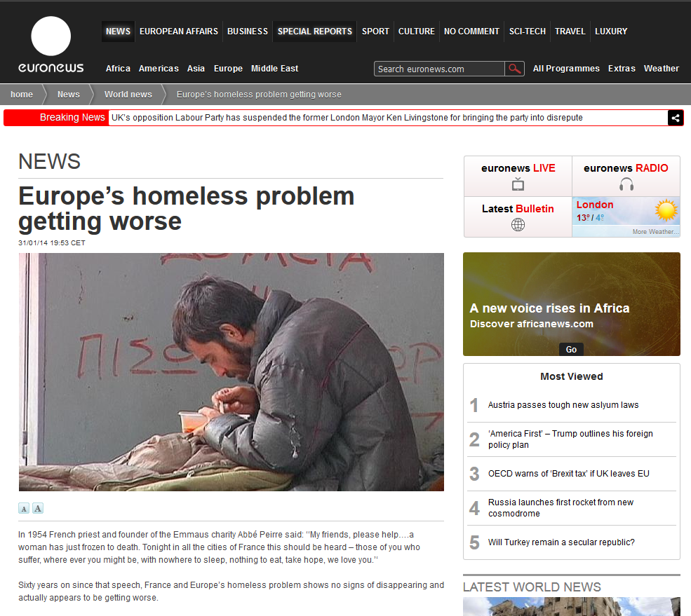
#2 What’s the problem?
Write a problem statement to identify the behavior under study and describe how it has evolved over a specific time period.
UN SDG
#1 : Name the SDG
Problem statement:
Write your problem statement here.
Main source :
https://provide the link to your article
Provide a screen grab of your article here.

